Slide 1

Final Presentation

Slide 2




Team Members
Chris Larsen
Lead Developer
Brock Corbett
Developer
Mikal Callahan
Lead UI/UX Developer
Justin Goulet
Project Manager

Slide 3
Agenda
Project Background
Requirements
Progress Overview
Phases
Hours
Cost
Accomplishments
Documentation and Training Materials
User and Development Manuals
Project Development
Technology Research and Decision Matrix
Libraries Implemented
Recommendations for Future Development
Project Demo

Slide 4
Project Management

Slide 5
Requirements
Must Create a JS Widget using a Commercial Library
The Widget must represent a workflow, with different states read from JSON
Must be Customizable with a CSS Swap
Must be able to scale when a workflow contains many states
Nodes with children must display an indicator
Must be able to filter critical states

Slide 6
Phase Overview
Phase 1
Phase 2
lklk
Research possible solutions to achieve requirements
Develop basic wireframe with suggested layout
Decision Matrix
Skeleton Product
Adjustments to design, of required
Phase 3
Phase 4
Implement required functionality into skeleton product
Implement handling of missing information
Switch libraries
Rebuilt product
Added Additional Theme
Created Documentation

Slide 7
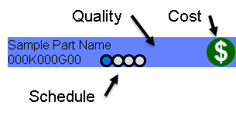

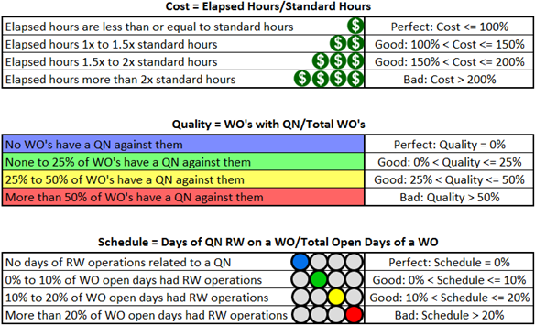
Visual
Requirements
Name
Quality
Cost
Schedule

Slide 8
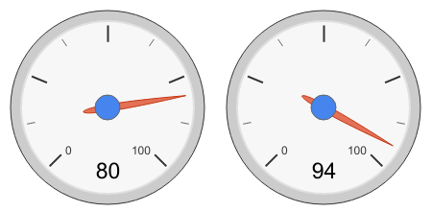
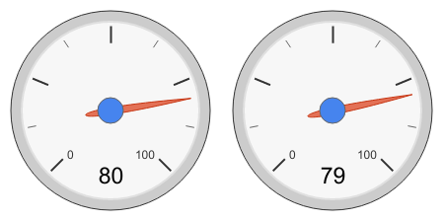
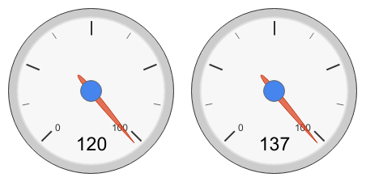

Phase Work Overview
Phase 1
Phase 2
lklk
Phase 3
Phase 4
Projected VS Actual
Projected VS Actual

Slide 9
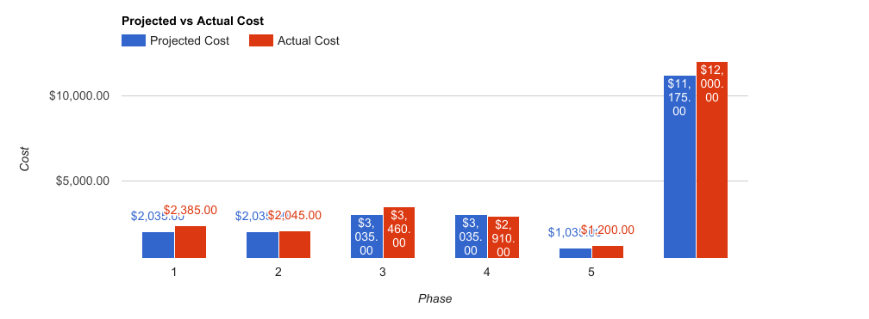
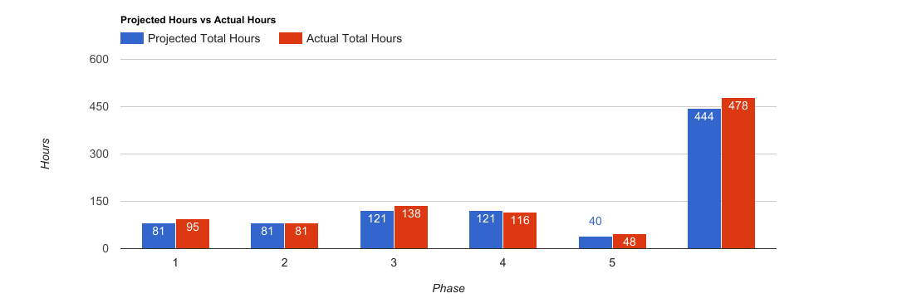
Project Progress

Slide 10
Project Documentation
User Manual
Development Manual
Very basic
Includes how to use the workflow diagram
In-Depth
Development level instructions on workflow management
Each component is documented in its relative folder
Some code displayed in breakdowns

Slide 11
Project Development

Slide 12
Development
Initial development started with researching Javascript frameworks and libraries that could be used for this project
Looked for visualization libraries and web app frameworks that could be combined easily
Commercial Libraries Considered
Open-Source Libraries Considered
Sencha ExtJS
Vaadin
Highcharts
D3
GoJS
Angular 2
React
jQWidgets
Notes:
Also wanted it to be easy for Northrop to continue developing

Slide 13
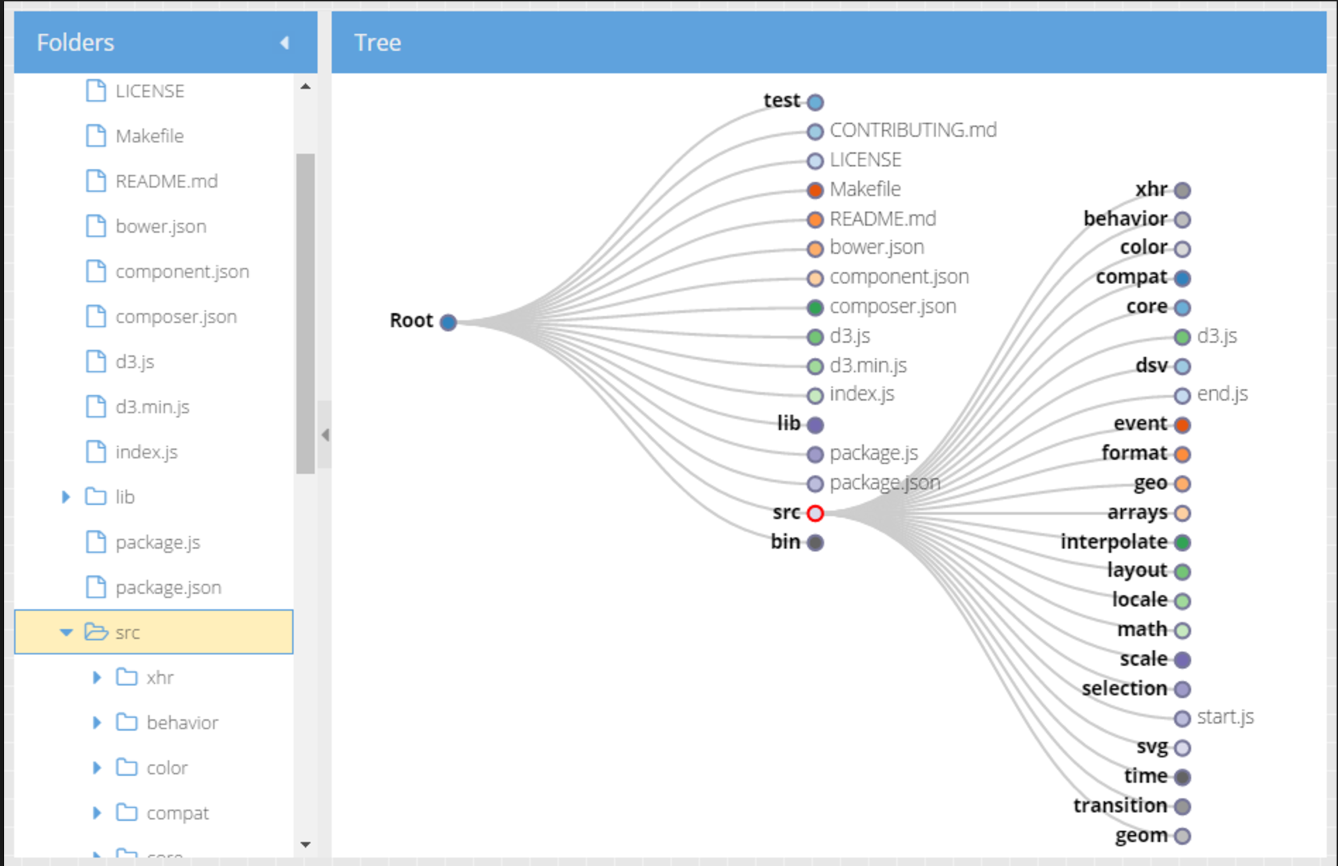
Development (Cont.)
Eventually settled on Sencha ExtJS and D3 as Northrop had used it before and ExtJS had a plug-in for D3
We thought we had selected the ideal framework and library for the job

Slide 14
Development (Cont.)
WE WERE WRONG!!!
Basic D3 tree example = easy
High level of customization = NOT easy
So what do you do?

Slide 15


Development (Cont.)
Solution

Slide 16
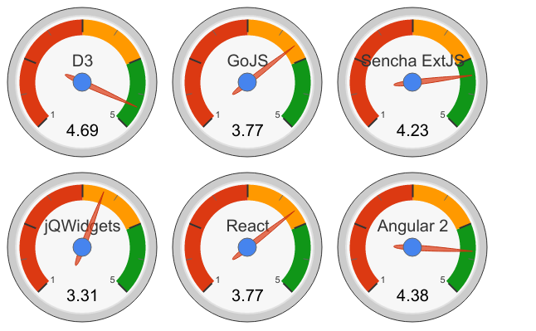
Decision Matrix
Total Averages Based on Scale
1
3
5
Implemented D3 and Angular 2

Slide 17
Development (Cont.)
Angular was much more straight forward from a development standpoint
Bigger community
Better documentation
Built around reusable components
Maintained by Google
Focus on componentization meant that we could break out the components independently
D3 tree
Widget controller
Data service

Slide 18
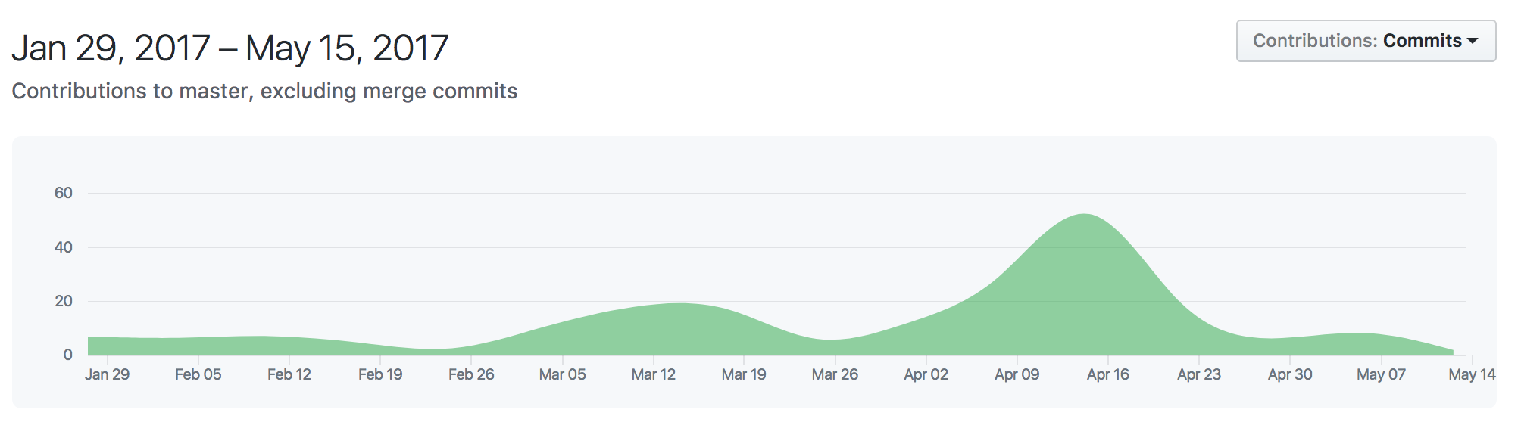
Development (Cont.)
After switching to Angular development productivity increase substantially
Switched to Angular

Slide 19
Transitions
Switching from Angular to Angular2
Time consuming but left with more options
Typescript & Web Components
Stronger templating system
Switching from D3v3 to D3v4 was a challenge
Less documentation
v4 divides library into import-able components allowing for a smaller app
Important to keep up with updated libraries

Slide 20
Project Recommendations
Expanding Nodes when Clicked
Admin / User Views
Scheduling / Personnel Components
Auto-Collapsing / Expanding Nodes

Slide 21
Widget Styling and Design

Slide 22
Widget Styling and Design 1
The design of the widget needed to be simple yet informative
The first thing that catches the eyes in the widget are each of the
state’s colors
This gives the user an immediate idea of what the quality of each state is like
Blue being the best, followed by green, then yellow, and finally red
The state’s name is displayed BOLD for easy identifiability

Slide 23
Widget Styling and Design 2
In the flourish state:
Each state also shows where in the state’s schedule it is
As well as the state’s current cost
Both of these are represented with Font-Awesome
As the name suggests, the Simple State is more straightforward
In the simple state only the state’s name and quality are shown (represented by the color of the state)
These states are easily switched between at the top of the widget
using the toggles “Show Simple” and “Show Flourish”
*

Slide 24
Widget Styling and Design 3
No matter the state, hovering a state will bring up its description and progress via tooltip
When a state is clicked a modal appears with all the state’s details:
ID
Name
Description
Status
Iteration
Percentage complete
Actual and planned hours
And the start and end date
This is all displayed in a large easy to read font-size in a modal using Twitter’s Bootstrap within Angular

Slide 25
Project Demo

